Slide 1
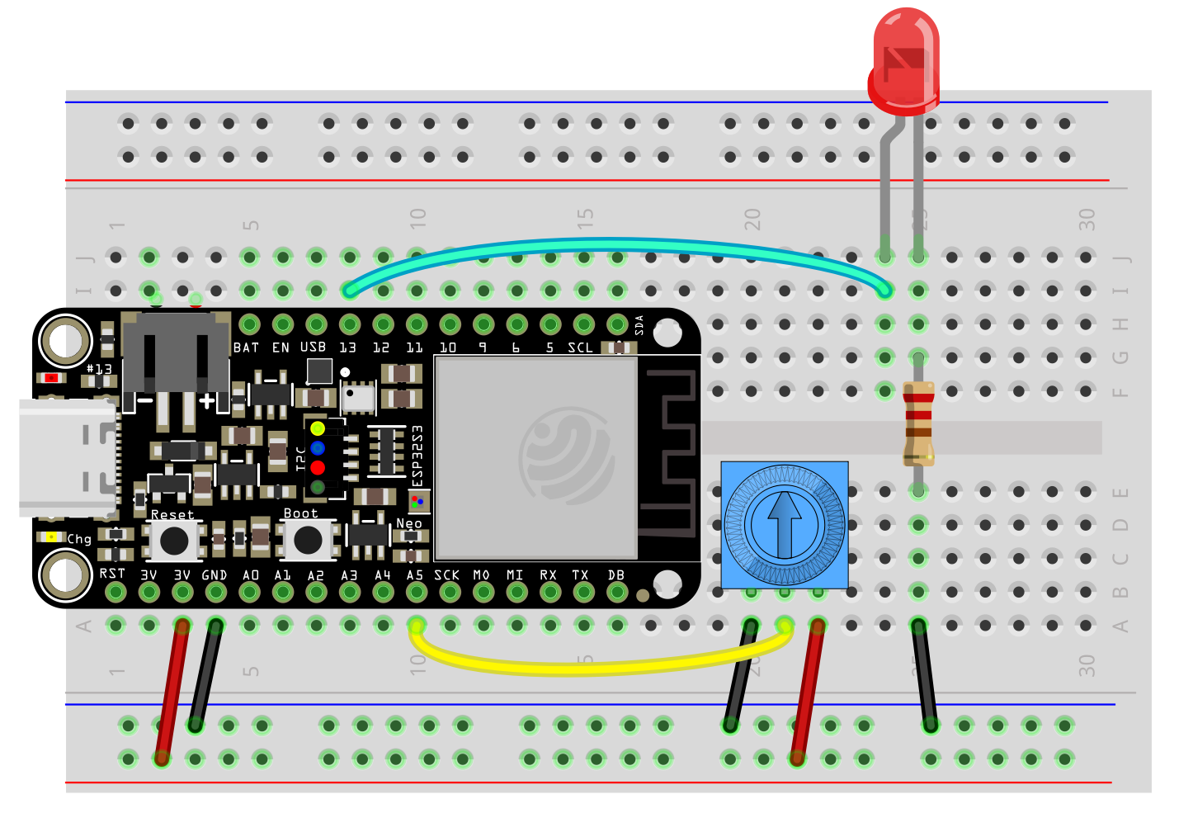
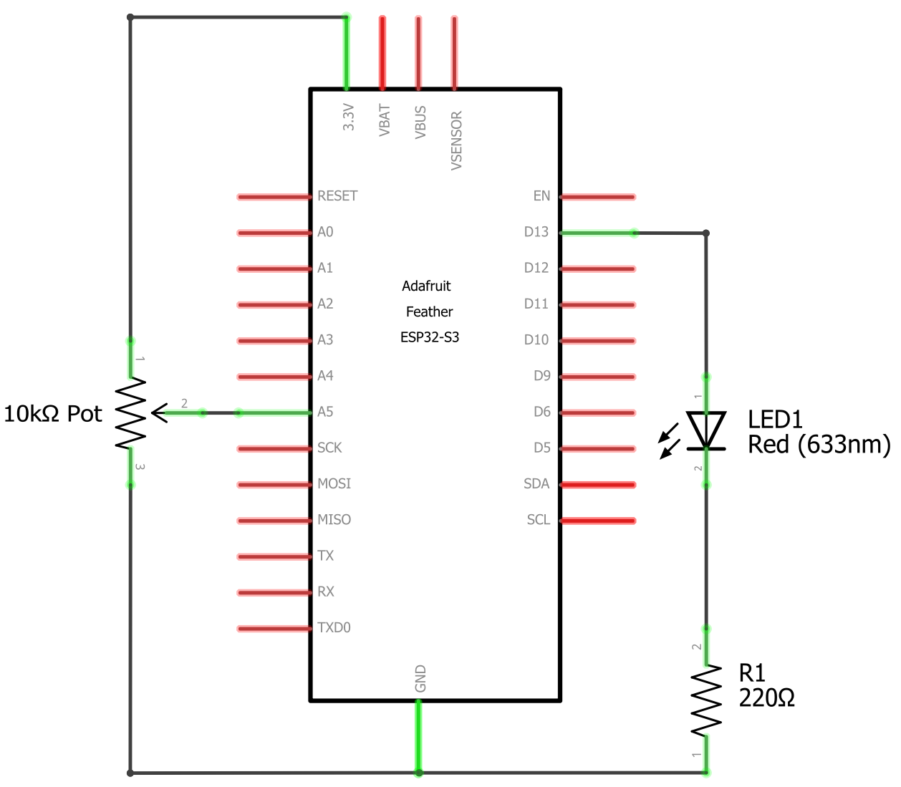
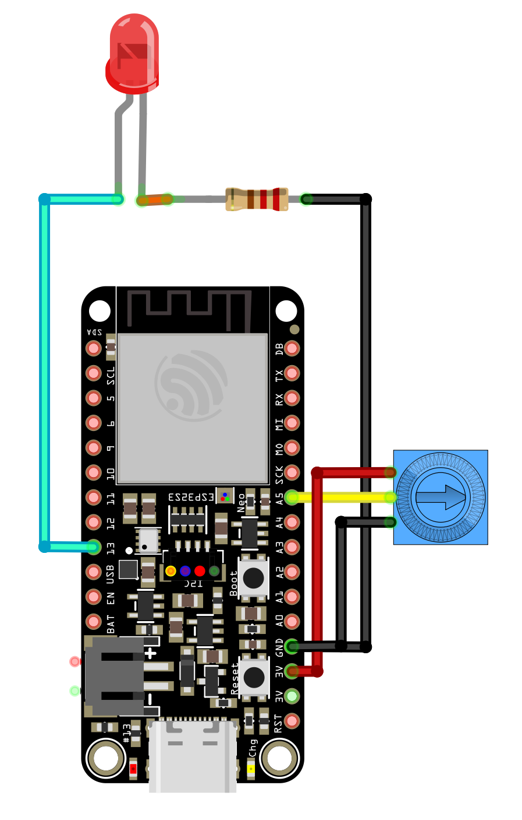
ESP32-S3 feather POT Fade Circuit Diagrams
Similar wiring to blinky and LED fade but with a potentiometer hooked up to A0.
No Breadboard
breadboard
Schematic

